Slide 2
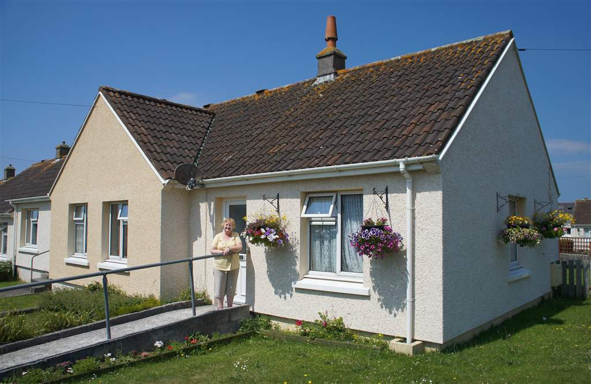
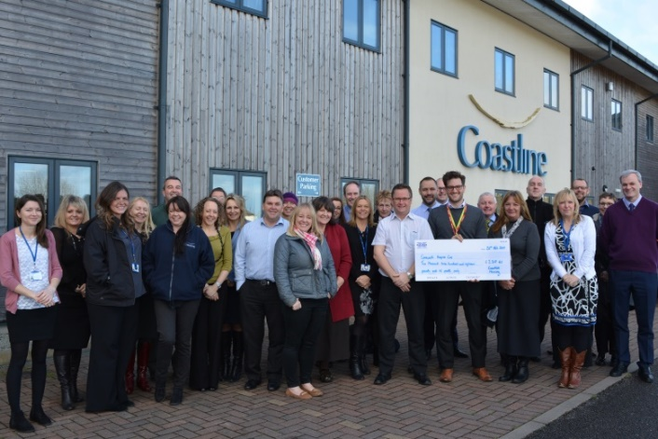
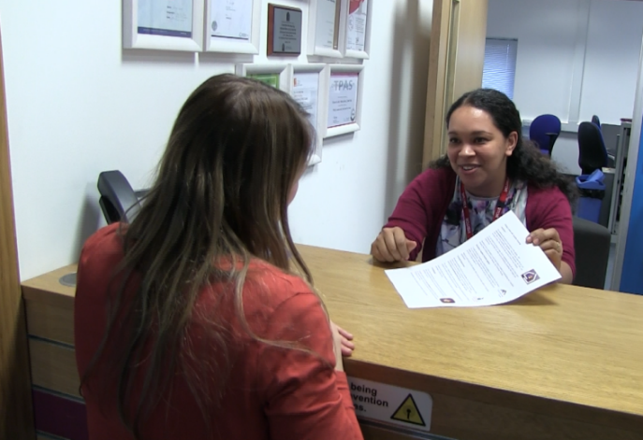
Coastline – a housing charity
Our mission and vision:
Great homes
Great services
Great people
Great foundations
Notes:
5,500 homes
Extra Care
Homeless
Repairs and maintenance
350 ish colleagues

Slide 3
Quick Stats…
5500 homes all in Cornwall
Rent, Supported, Shared Ownership and Leasehold
350+ colleagues
£30 million per year rent income
350 lettings per year 95%+ to people with a Cornwall connection
We build 250 – 300 new homes each year and sell 50.
600 – 1000 repairs carried out each month.

Slide 4
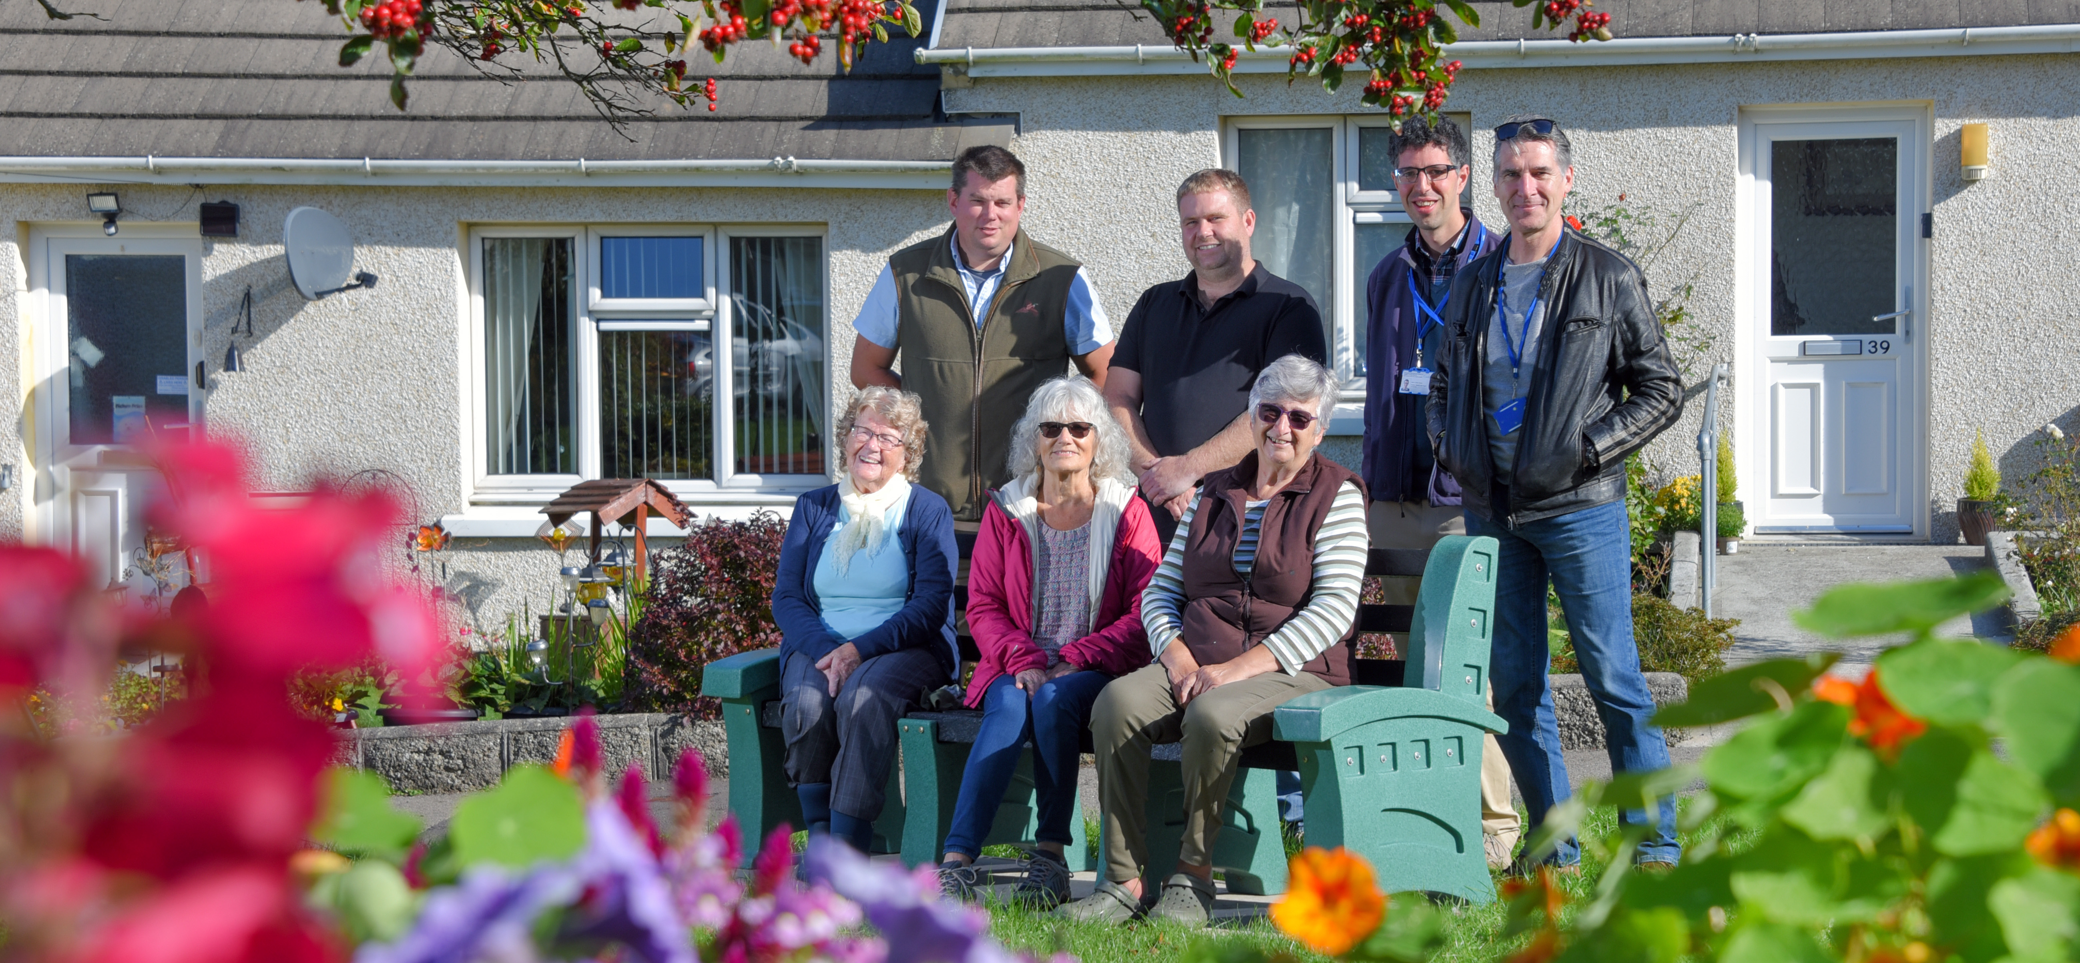
Housing associations?
Private, but all are charitable: we do not take profit and leave, we invest and stay
More than 2.5m homes for 5m people, including 373,000 for older and vulnerable people (22,000 homes in Cornwall)
Vary in size from 10 homes to more than 100,000 homes
Across England 39,000 homes built in 2022/23 (1/5 of all new homes)
Economic drivers for Cornwall: £184m annual turnover, £91m GVA and over 2,000 jobs, over £50m rent saved
Notes:
Housing associations are all charitable
That means that every single of £ that comes into us (mainly from rent, but also shared ownership sales, open market sales and various contracts) goes straight back into the charitable work we do.
None of it leaves through dividends.
In simple terms, we do not take profit and leave, we invest and stay.
Scale is significant, in Cornwall, and across England.
While we are private, we are heavily regulated by government through the RSH and other legislation, so the sort of work we do, the sort of homes we provide, is steered (for better or worse) quite directly by government policy.

Slide 5
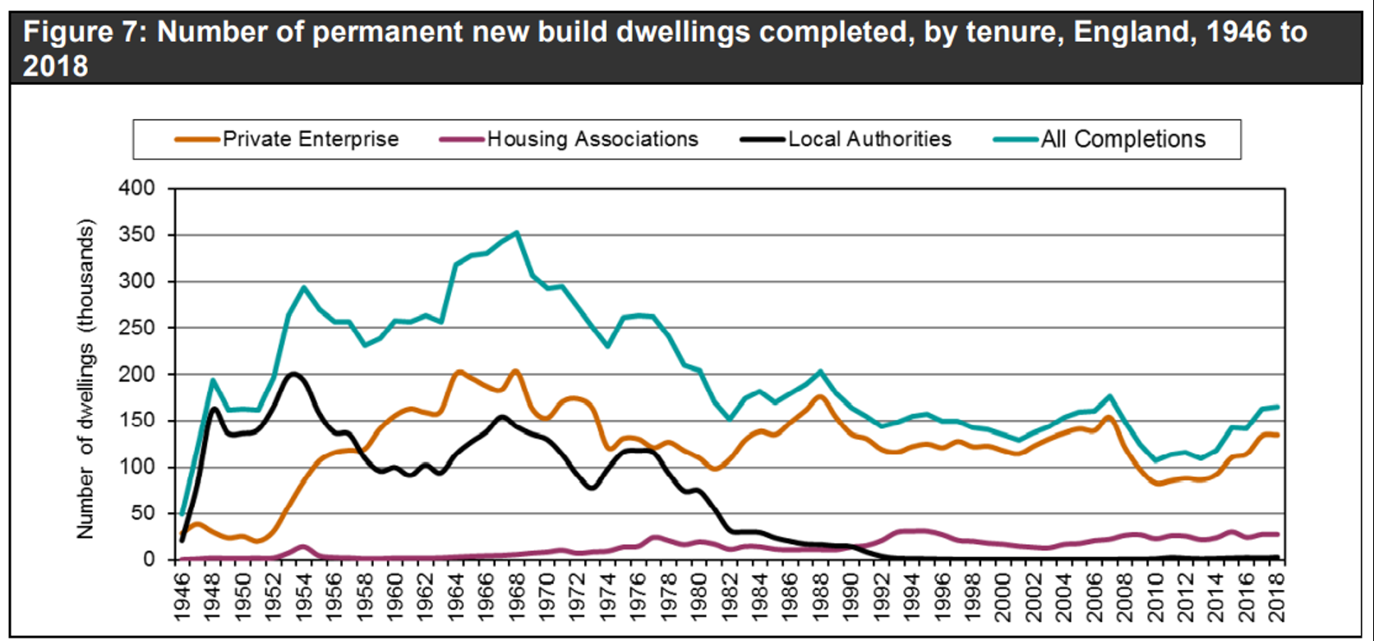
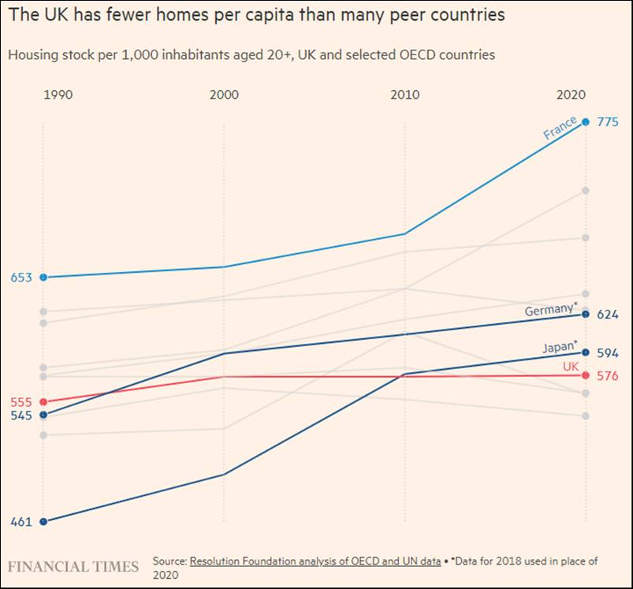
How big is the problem? Big. In terms of numbers.
Notes:
Why are we here? There are two fundamental issues I would highlight. Both of which speak to a failing of successive governments to either set and implement a cohesive strategy, and to my mind standing back and saying ‘the market will sort it out’.
Firstly, we haven’t built enough homes. Private sector does what it does in response the market. Government has largely stopped. HAs have filled some of the gap, but we’ve from 250,000/300,000 a year to 150,000/200,000 a year.

Slide 6
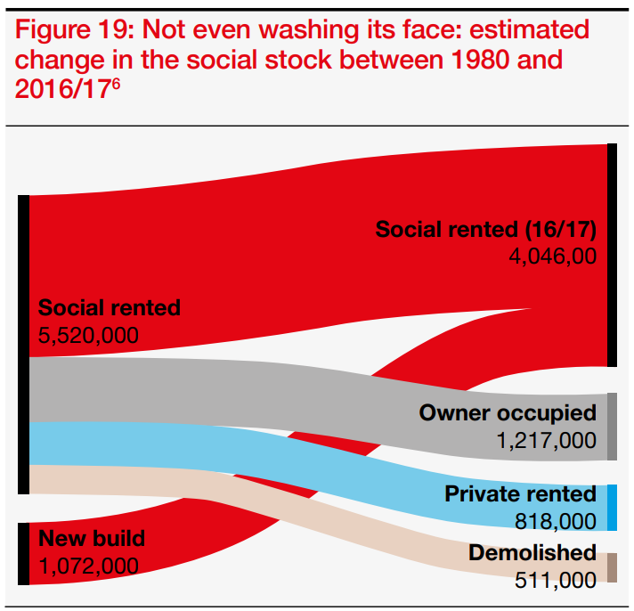
How big is the problem? Big. In terms of numbers.
1980: 5.5 million social rent homes
1980–2017: 1.1 million new social rent homes built
1980-2017: 2 million RTB sales and 500,000 demolished
Now: only 4 million social rent homes
Notes:
And at the same time we’ve been haemorrhaging the stock of social housing we have.
In 1980 there were 5.5m social rent homes.
Since then we’ve build 1.1m new social rent homes.
But we’ve lost 2.5m homes (2m through the RTB, of which 800,000 are now private rent!?)
So there are now only 4m.
What does this mean?

Slide 7
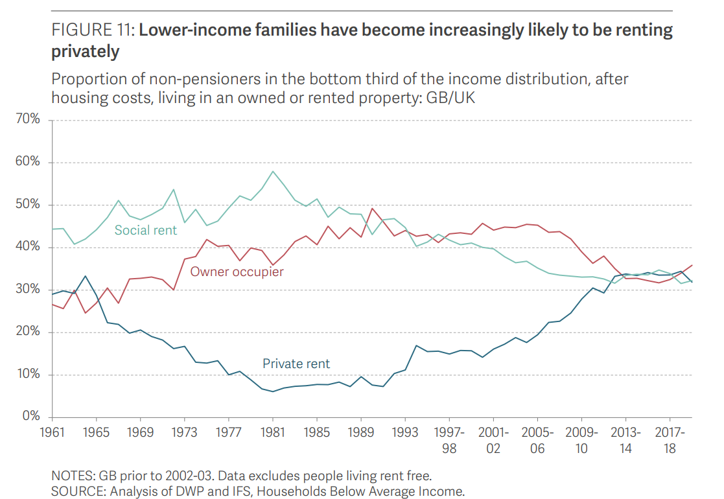
How big is the problem? Big. In terms of impact.
Notes:
Well, in 1981 55% of families in the bottom third of the income distribution lived in secure, affordable housing. Only 8% lived in insecure, expensive private rent.
By 2018 there was still about the same 2/3 in rented accommodation, but the same number in PRS and social sector.
So, a significant increase in families – ie people with children – in insecure expensive housing
Which is a HUGE public policy and economic policy failing.
Interestingly, I think Simon Reeves touched on some of this in his recent programme.

Slide 8
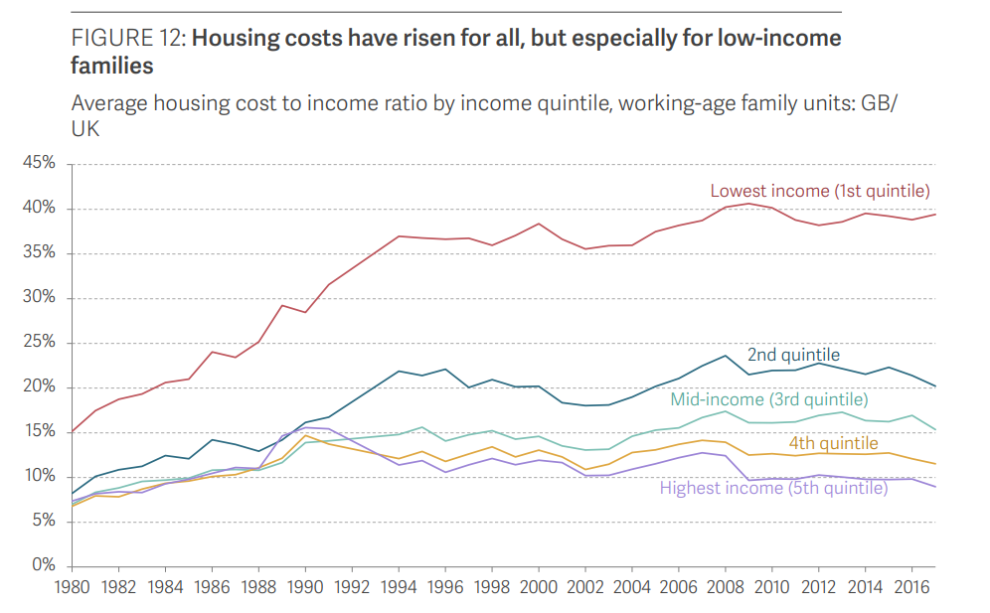
How big is the problem? Big. In terms of impact.
Notes:
As an aside, for those families, it means they have gone from, on average, paying 15% of their income for housing, to more like 40%.
Oh, and don’t forget, that cost is very likely being subsidised by tax payers. So think back to that disposal of RTB on into the PRS…

Slide 9
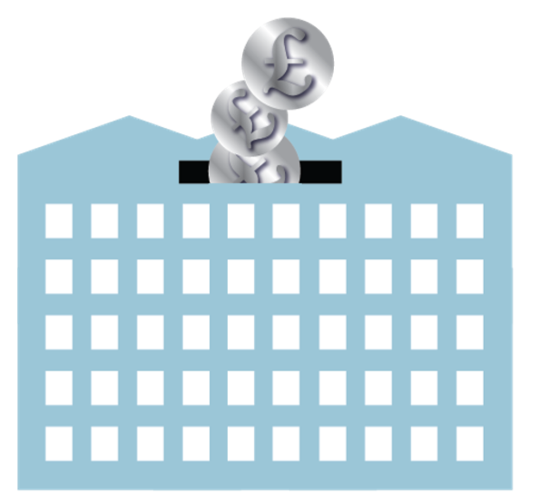
How big is the problem? Big. In terms of impact.
Notes:
The wider impact?
Cost to the NHS
Deaths – about 10,000 a year
Impact on businesses and the economy

Slide 10
So how big do the solutions need to be?
1 million fewer homes than we need
Space for 200,000 to 1 million homes on ‘brownfield’
Need to build 500,000 homes a year
50,000 migrants on small boats a year
Of that, 90,000 need to be ‘social homes’
261,000 empty homes (and…)
26,000 on Cornwall waiting list
24,000 2nd/holiday homes in Cornwall
Notes:
People don’t realise how big the problem is, compared to the things they think will solve it/make it go away.

Slide 11
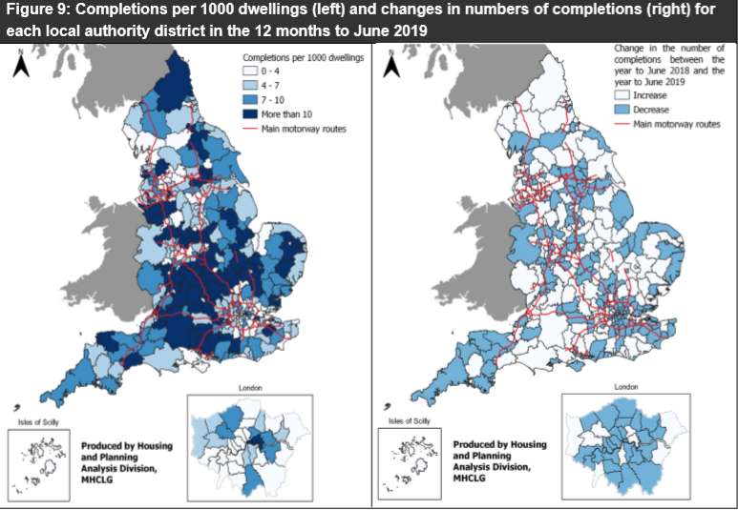
OK! Some positivity ☺. Cornwall is (relatively) good at building new homes.
Notes:
But let’s start to be positive
Cornwall does better than most areas
Aside on Housing Associations
– this shows growth of over 1% as being positive
Housing Associations average about 2%
In Cornwall closer to 5%

Slide 12
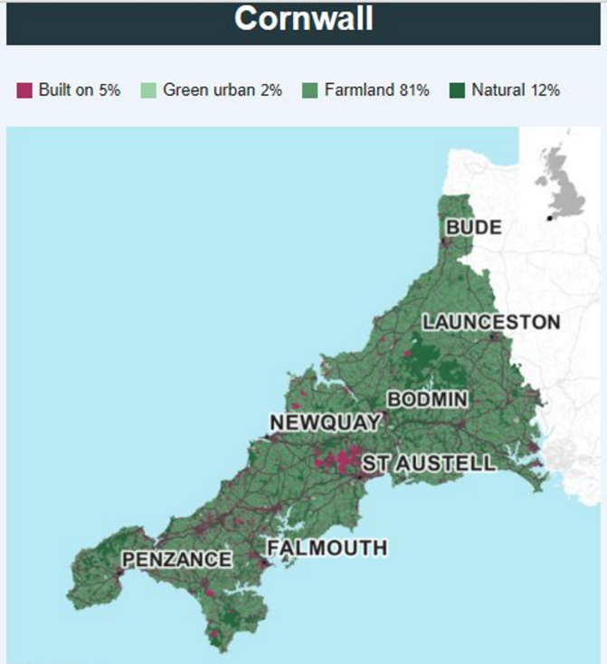
Some more positivity ☺. There is plenty of space.
Notes:
We’re often told there’s no space.
There is.
5% would increase to about 6% over the course of the local plan.
That doesn’t mean we always build the right homes in the right places.
But don’t think ‘brownfield’ is a magic solution.
Nationally, space for about 1.4 million
Government says we need to build about 300,000 homes a year.
You do the maths.

Slide 13
Notes:
To make the same point in a more eloquent way…
25 million homes in uk
So 10 years would add about 10%
So from 4.9% to 5.5%

